Slide 1


Intravascular OCT
Case Report:
Optical Coherence Tomography guided
Right Coronary PCI case
Hospital Clinicas Caracas, Venezuela
Dr Lewis Carrasquero
Dr Enrique Fermin

Slide 2
Patient Information

Slide 3
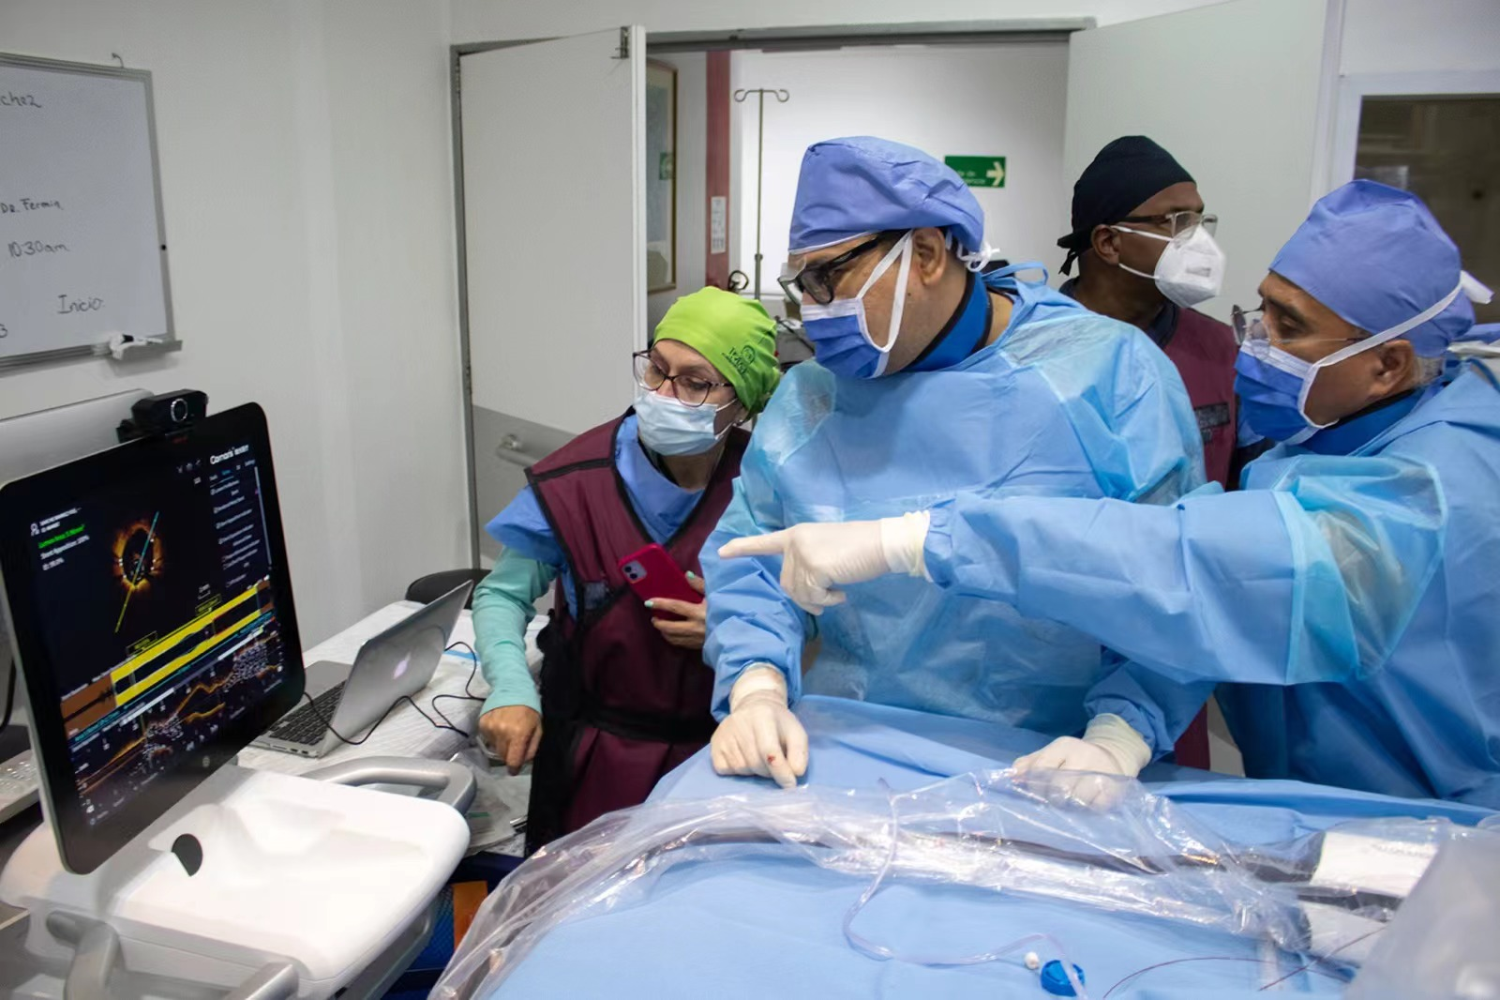
Procedure Summary
Angiography results: this case was a 90% stenosis of the right coronary artery
Pre-dilatation with a small 2.0x15 balloon
1st OCT pullback scan was completed after pre-dilatation. VFR value of the OCT based algorithm for functional assessment of the coronary artery was 0.73 suggesting the need for PCI intervention. There were a few calcified plaques present but the calcification score was only 2. Locally unstable plaques were found but suggesting that they were not serious.
Implanting two stents, 3.5x20 and 3.0x24 in the proximal and distal right coronary
Post-dilation: 3.0 x 12 baloon NC
2nd OCT was performed after implanting two stents. The average stent adherence rate reached 98.9%; the minimum expansion index of the proximal stent was 94%, and of the distal stent was 84%.

Slide 4
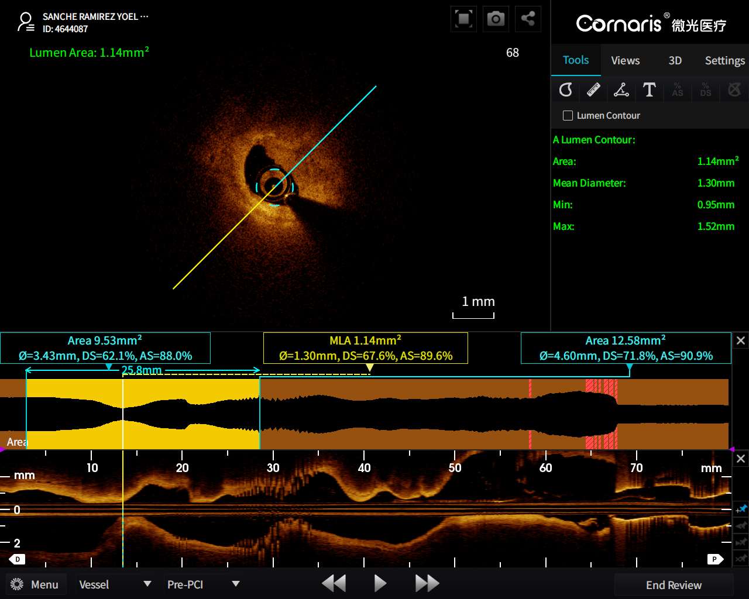
1st OCT Pullback after pre-dilation

Slide 5
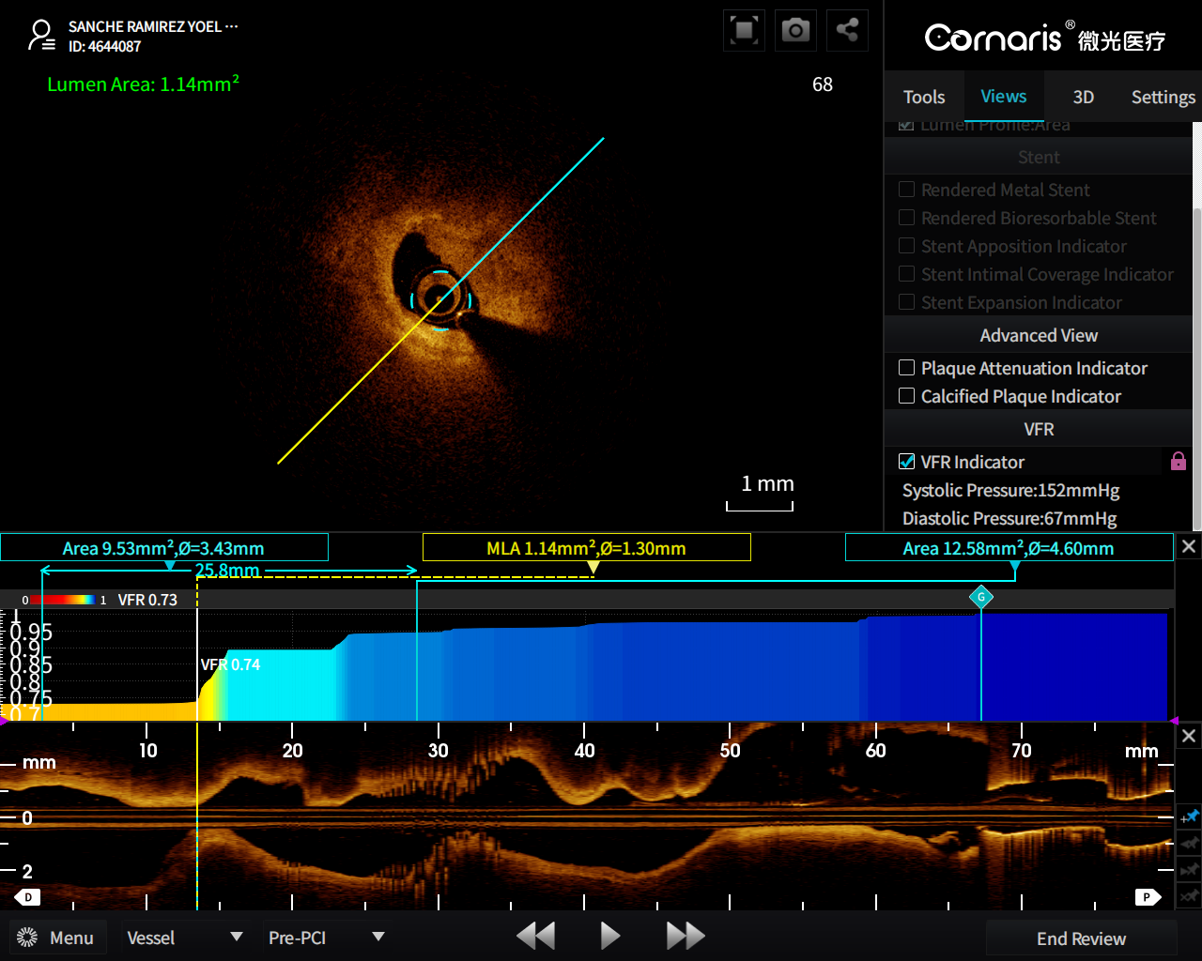
1st OCT Pullback: VFR 0.73 suggested PCI

Slide 6
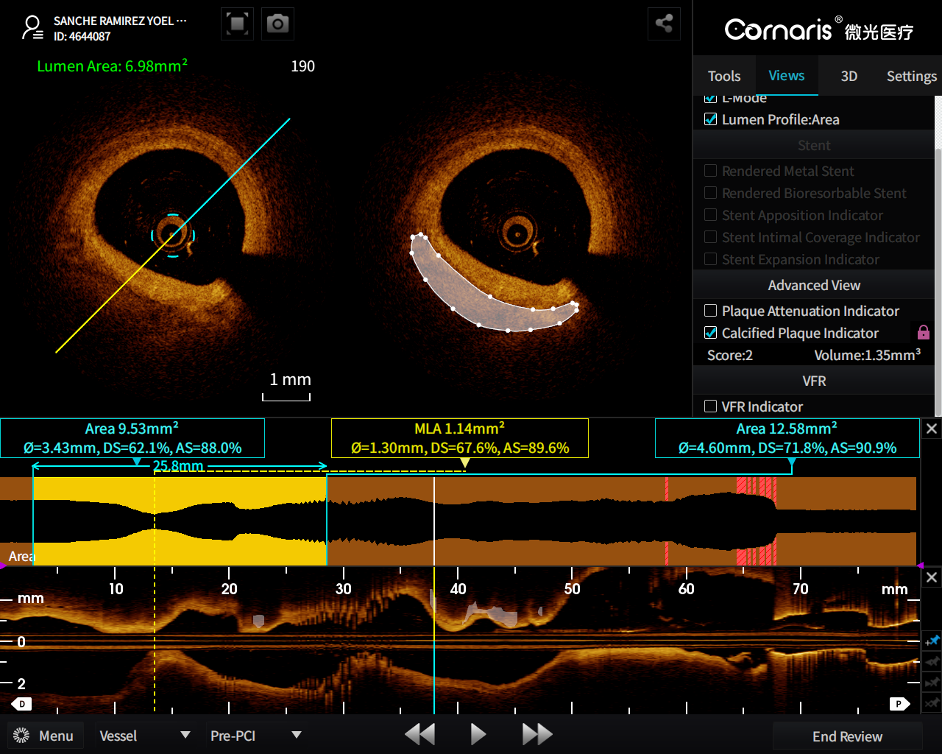
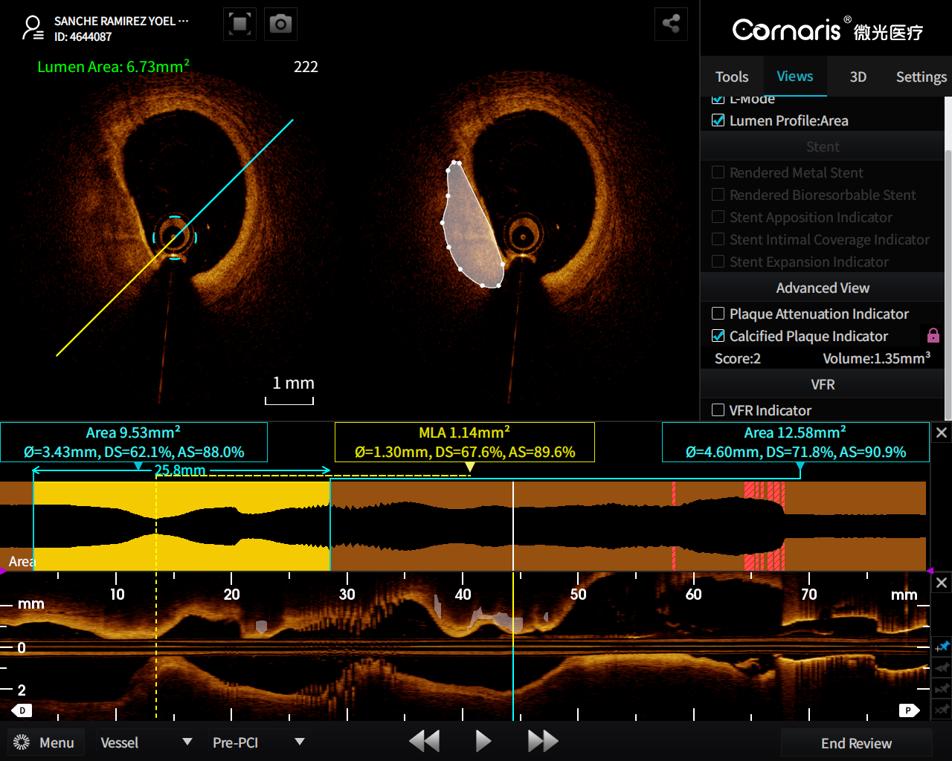
1st OCT Pullback showed some calcification
The white translucent markers in the cross-sectional and long-axis views are calcified plaques automatically recognized by ICA function.

Slide 7
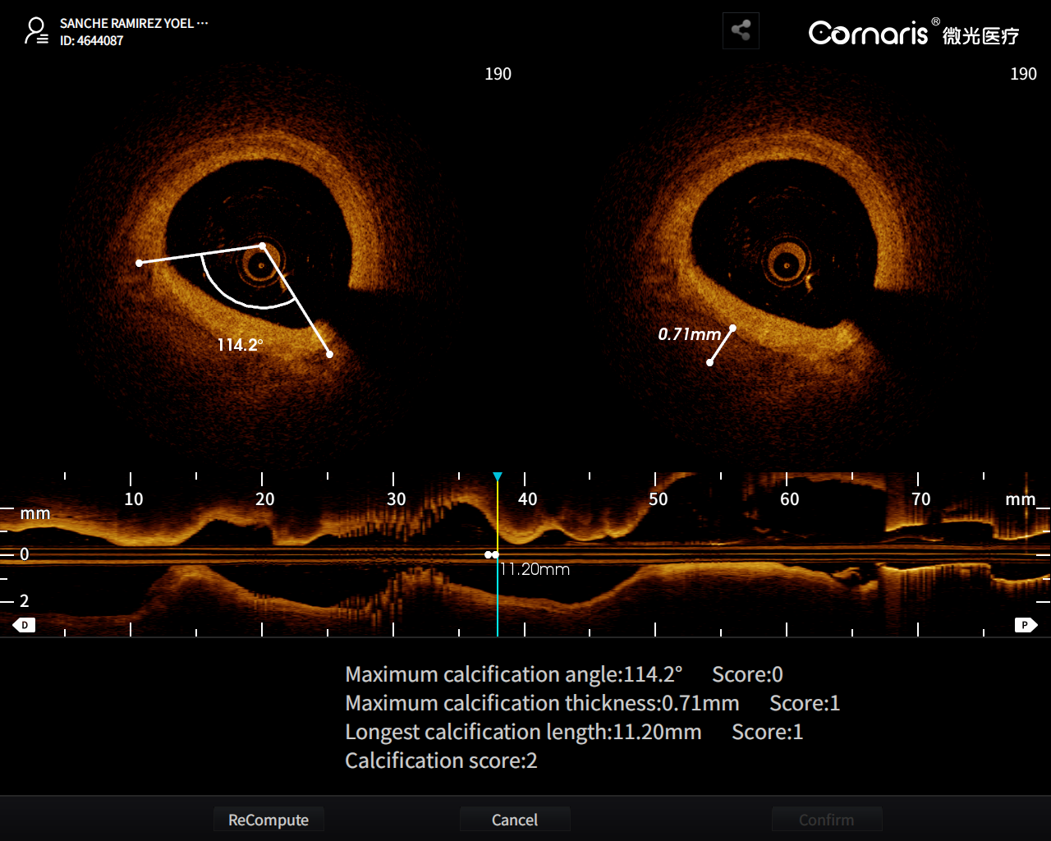
1st OCT Pullback showed some calcification
ICA(Intelligent Calcification Assessment)
An intelligent recognition and evaluation technology of calcified plaques developed by Vivolight based on artificial intelligence technology. The research results showed a 93.95% accuracy in recognizing calcified plaques and were published in The International Journal of Cardiovascular Imaging in 2022.
After the completion of OCT pullback, the system automatically identifies and marks calcified plaques in the entire pullback segment, calculates the calcification score, calcified volume and other parameters, which provides complete qualitative and quantitative analysis of calcified plaques, and guides the PCI strategy.
The ICA automatically calculates the calcification score: 2
It suggests we don’t need special treatment.

Slide 8
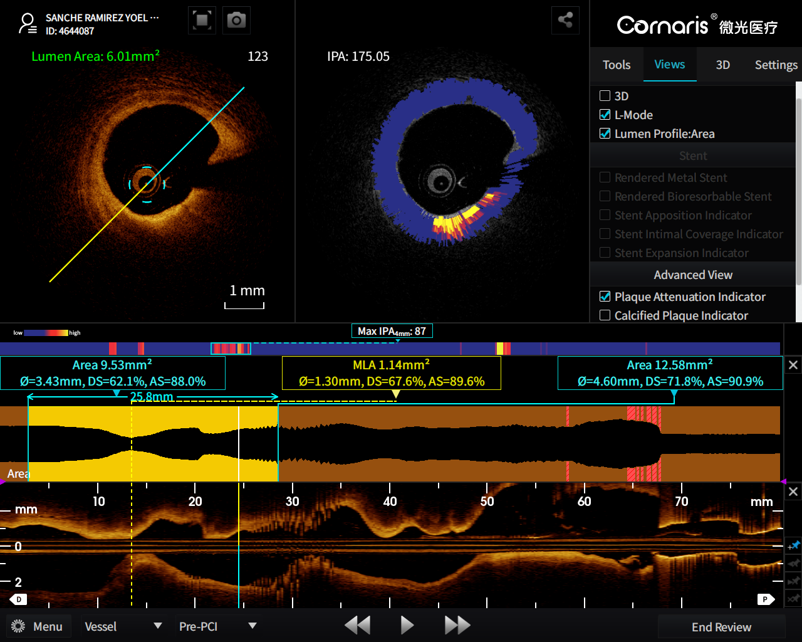
1st OCT Pullback: IPA showed vulnerable plaque and suggested stenting position
IPA (Index of Plaque Attenuation)
IPA was first invented by Prof. Gijs van Soest of Erasmus University Medical Center in Rotterdam, Netherlands, and carried out research work, which firstly confirmed the correlation between IPA and artificial lipid scores in an in vitro test, and proved that IPA's ability to identify TCFA was better than that of NIRS-IVUS in a clinical study. In 2019, Vivolight promoted the transformation of IPA technology from an algorithm to a clinical tool, and carried out related clinical research and transformation with China’s key PCI centers, successfully realizing the graphical display and automatic calculation of IPA.
IPA uses a traditional OCT imaging catheter to automatically complete plaque stability assessment with a single OCT pullback scan. The light attenuation coefficient map can visualize the light attenuation characteristics (i.e., plaque stability) of each OCT cross-section frame and realize "qualitative" analysis. The higher the IPA value, the more unstable the plaque is.
The IPA technique identified an unstable plaque in this frame from 4-6 o'clock, which was labeled with yellow and red. Stent implantion needs to avoid these position.
OCT images revealed the presence of a thin fibrous large lipid core structure with cholesterol crystals, which was consistent with the IPA suggestion.

Slide 9
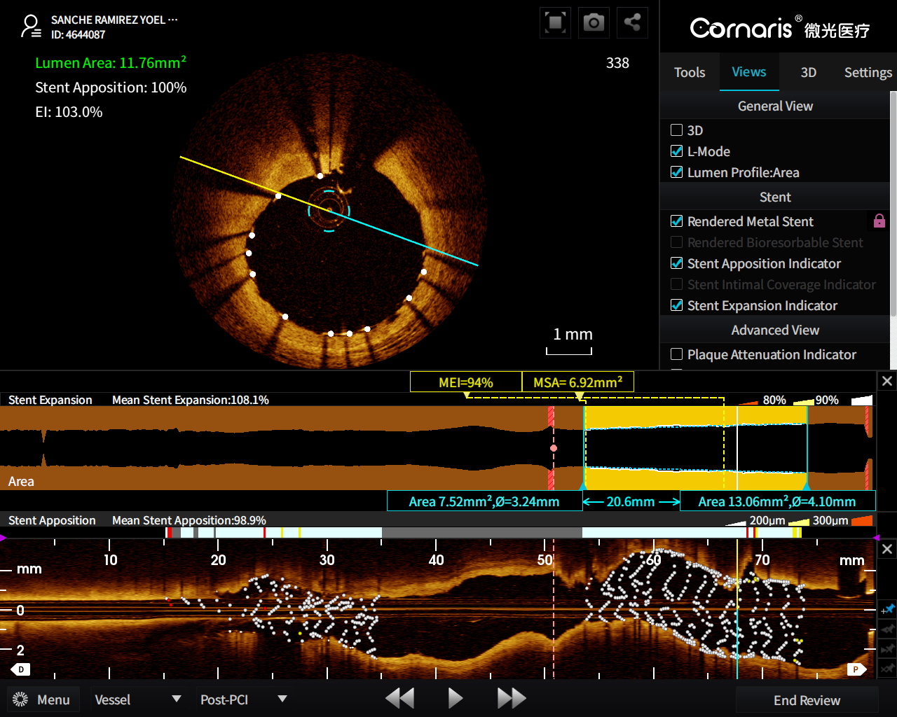
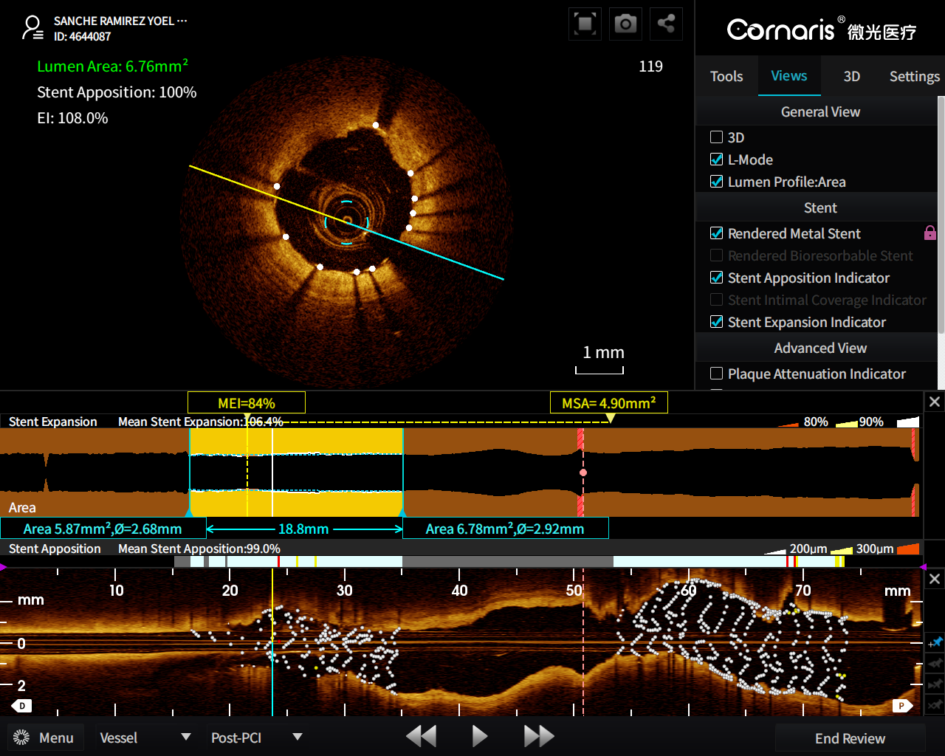
2nd OCT Pullback after stents implantation
Proximal stent has good apposition of 98.9%,
with a minimum stent expansion index of 94%
Distal stent has good apposition of 99%,
with a minimum stent expansion index of 84%

Slide 10
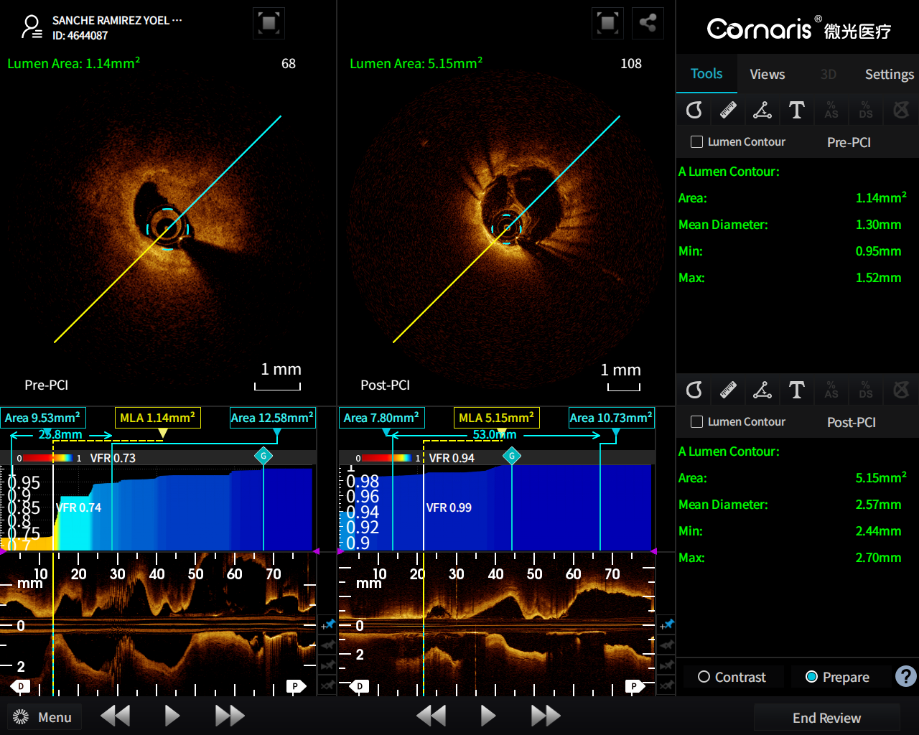
2nd OCT Pullback VFR 0.94
VFR (Virtual Flow Ratio)
A coronary functional evaluation technology developed Vivolight. Different from traditional OFR algorithm, the VFR algorithm developed by Vivolight makes integrative calculation based on the value of aortic pressure to further improve its accuracy.
Clinical researches showed its accuracy to be as high as 98.1%. Vivolight OCT provides the physicians with a coronary functional index (distal VFR value) and a complete VFR curve immediately after an OCT pullback, so as to guide the PCI strategy.
The entire VFR check neither requires the use of extra devices (such as pressure guidewire and pressure catheter) other than OCT catheter, nor requires the use of adenosine, ATP or other drugs for angiectasis. It neither increases medical costs or procedure time, nor causes patients to experience discomfort symptoms related to drugs.
PCI fusion of Pre and Post PCI comparison
Pre-VFR (Left) 0.73 & Post-VFR(Right) 0.94
Notes: since we didn’t flush the lumen very clear, so the post-PCI VFR was manually adjusted by software engineer team from Vivolight.

Slide 11
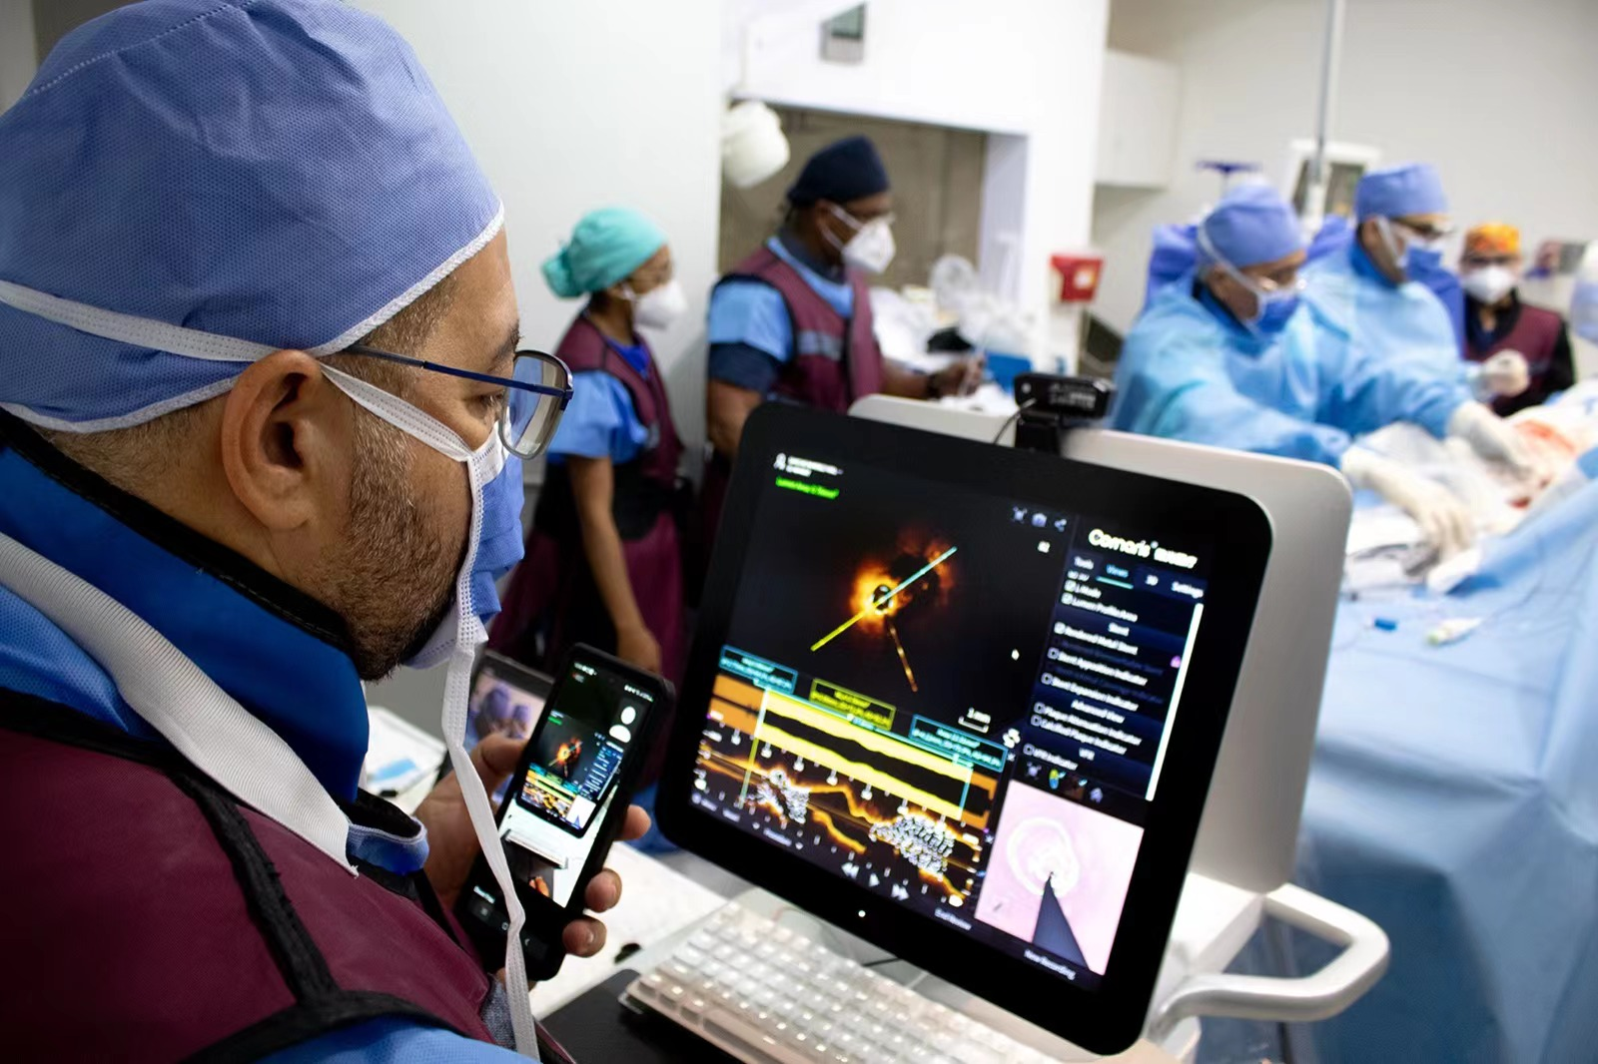
OCT summary
Clear OCT images provides more lesion information to physicians.
ICA technique based on artificial intelligence can automatically identify calcified plaques, calculate calcium score and volume in order to adopt optimal lesion pretreatment strategy.
VFR provides information of coronary functional evaluation without extra time and consumables.
IPA provides suggestions to vulnerable plaques and stenting position.
Thanks to its ultra-high resolution, OCT can accurately evaluate stent apposition and expansion.

